Slide 1

Welcome
EIC EDGE – Session 1
Notes:
Mandatory
ACTION: Adjust title to fit your course.

Slide 2

Hello
About me...
Developer
Architect
Author
U.S. Navy veteran
Ran a nuclear sub in Idaho (really!)
Erik Gross
with DevelopIntelligence, a Pluralsight Company.
Notes:
Mandatory
ACTION: Adjust objectives to fit your course.
Script: I am [insert name] with DevelopIntelligence. We’re the training partner for [insert client name]. [Provide brief info on your background.]
Wing it!!! Keep it short!!! (Under 2 minutes; less than 1 is even better). Your goal is to establish rapport. You’re just trying to connect with the students. For example...
Here’s a little about my background in case you want this for reference later. Fun fact: [insert a piece of trivia about your personal life…”When I’m not teaching or coding, I am a skydiver”…whatever cool hobby you are engaged in]
Avoid putting your resume here. Say only a sentence or two about your professional credentials and invite them to ask questions about your background or experiences at any point during the training.

Slide 3
Prerequisites
This course assumes you:
Have some education and experience in Computer Science and software development
Have completed basic onboarding
Notes:
Mandatory
ACTION: Adjust prerequisites to fit your course. Keep it brief.
Script: Before we start, I want to make sure everyone is in the correct class. Take a look at these prerequisites and message me in Chat if you have questions or aren’t sure you’re in the right spot.

Slide 4
Why study this subject?
Knowing how iterative software development works helps you confidently contribute from your role
Understanding Agile principles helps you work more effectively in teams
Understanding DevOps orients you to Capital Group’s tech culture and enables continuous improvement
Being familiar with JIRA and how it’s used helps you create, track and contribute to technology workflows
Notes:
Mandatory
ACTION: Adjust benefits to fit your course.
Examples...
Learning Python will let you….
You’ll be learning Python so that you can work on XYZ project…
Your organization will be using Python in its upcoming digital transformation project...

Slide 5
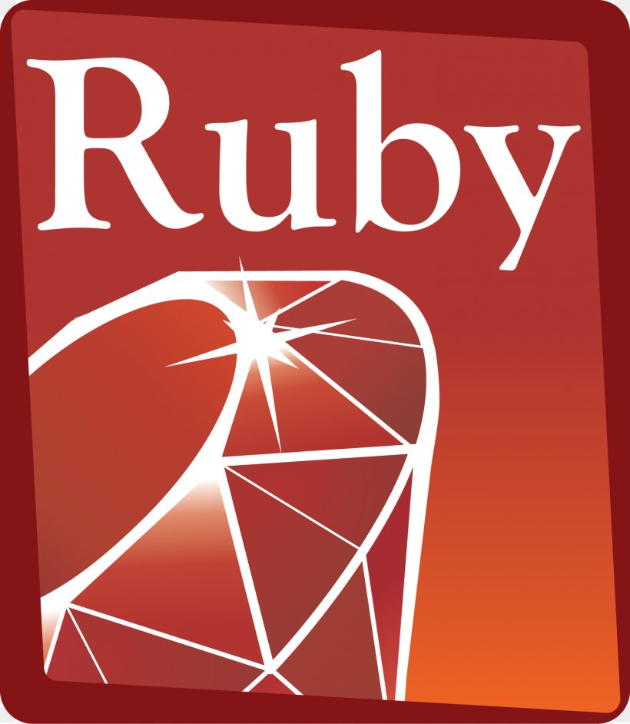
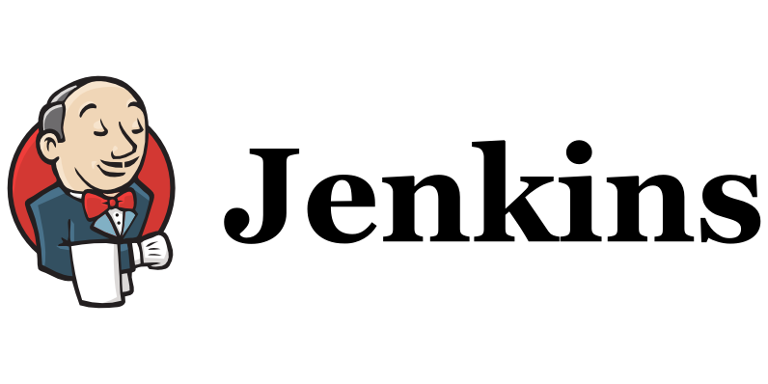
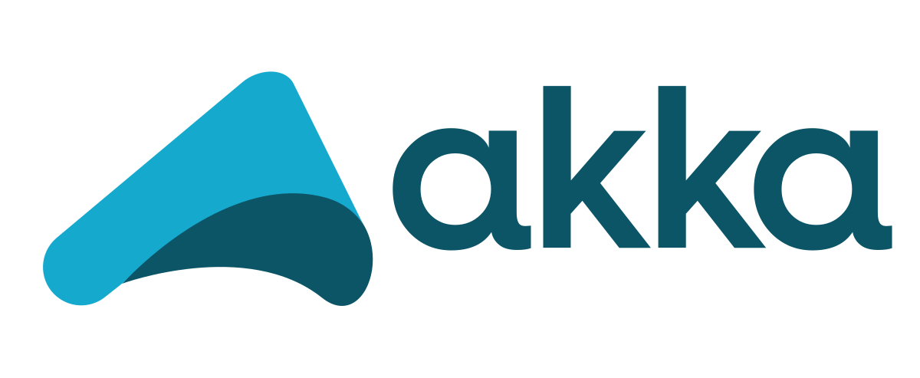

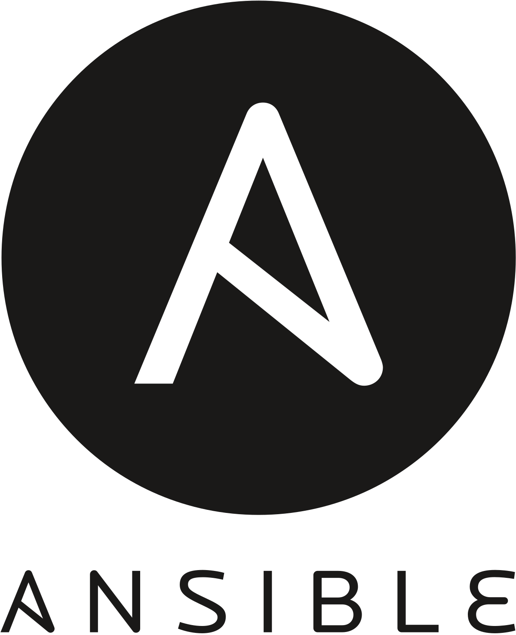
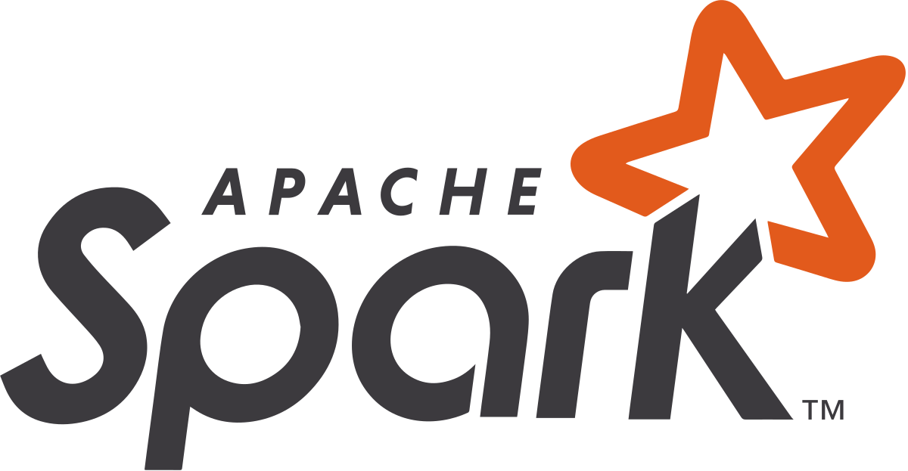

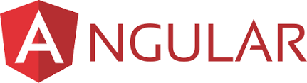
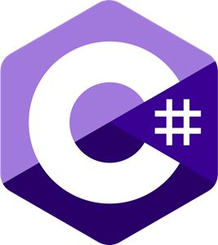
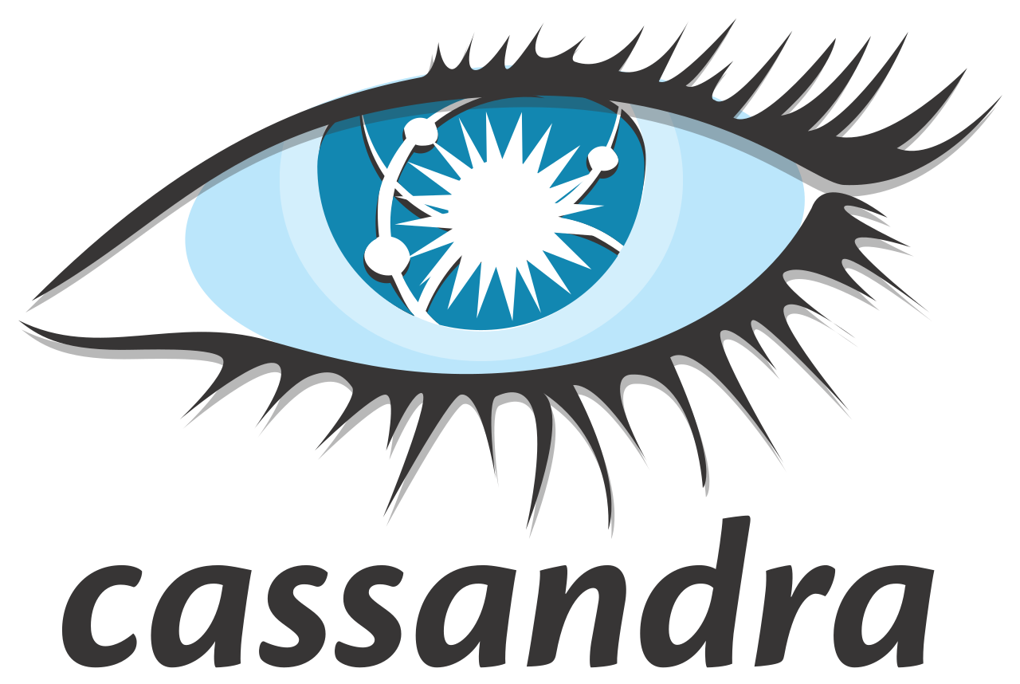
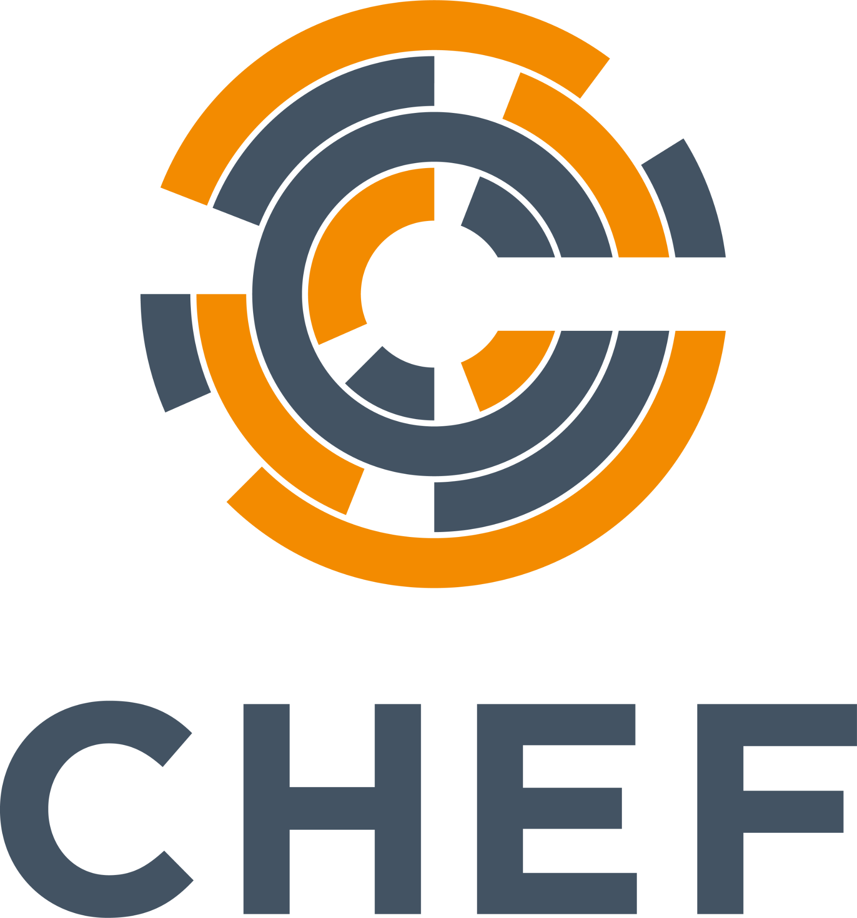





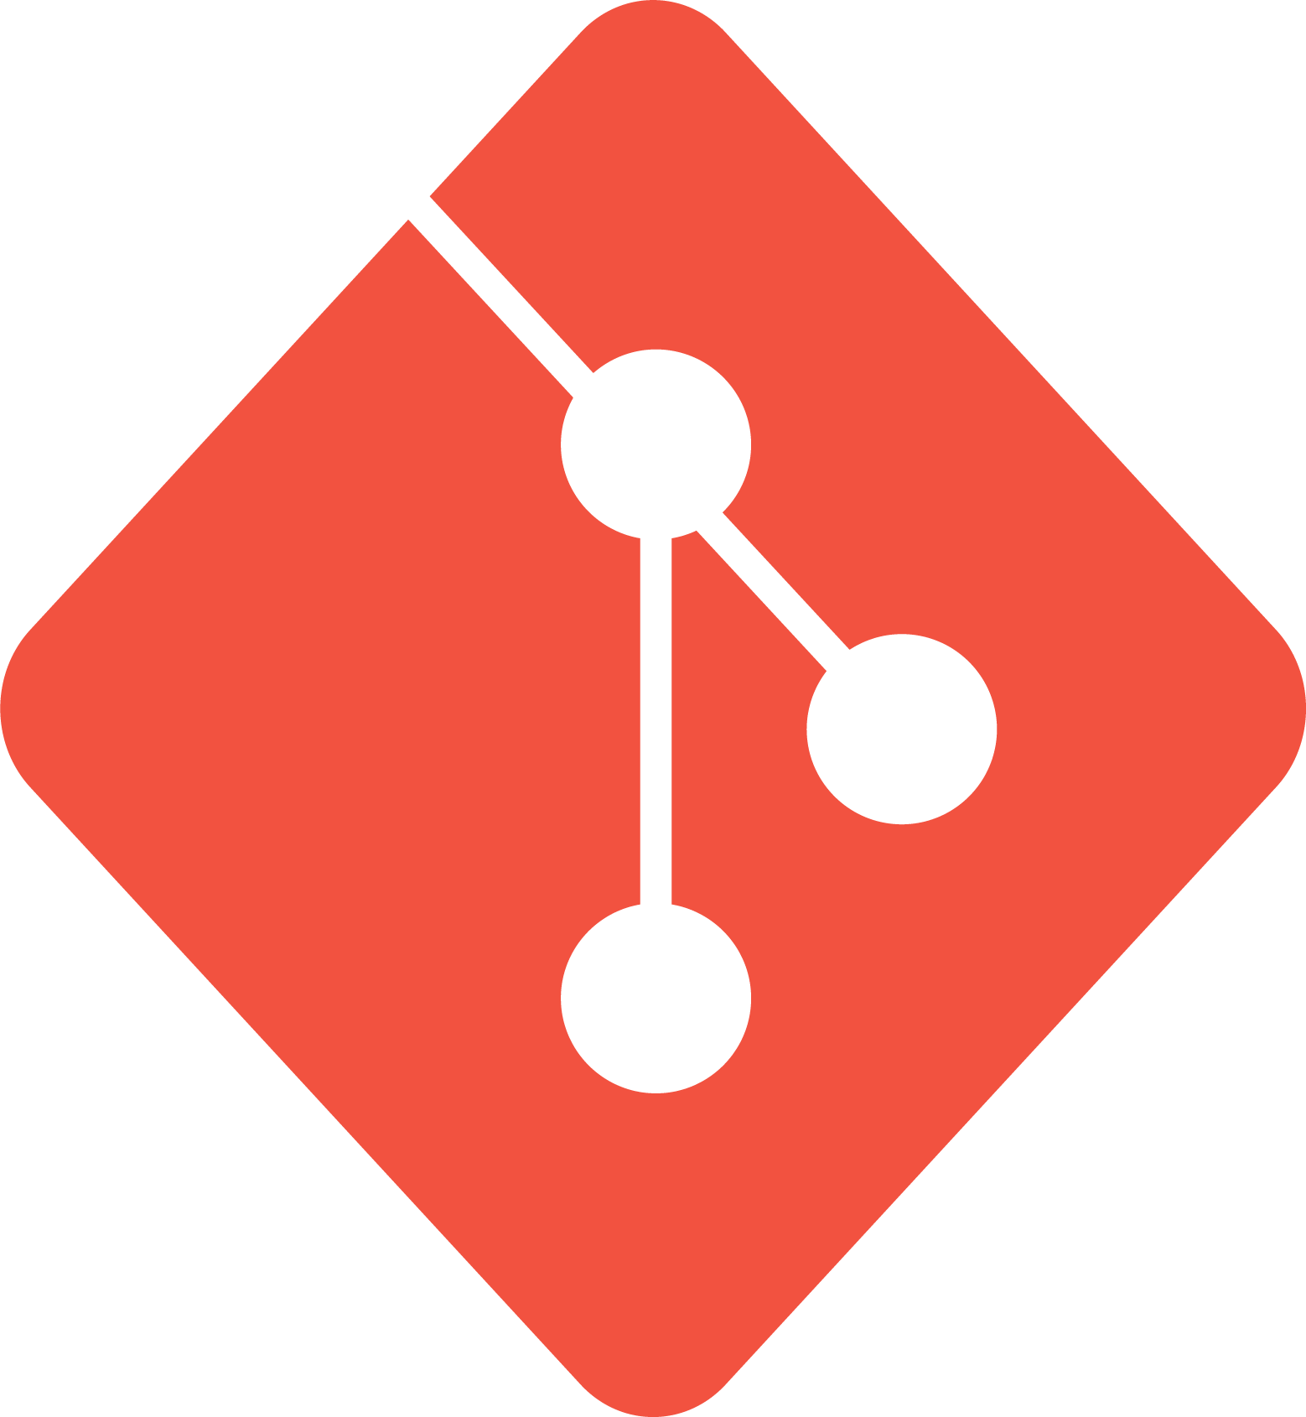
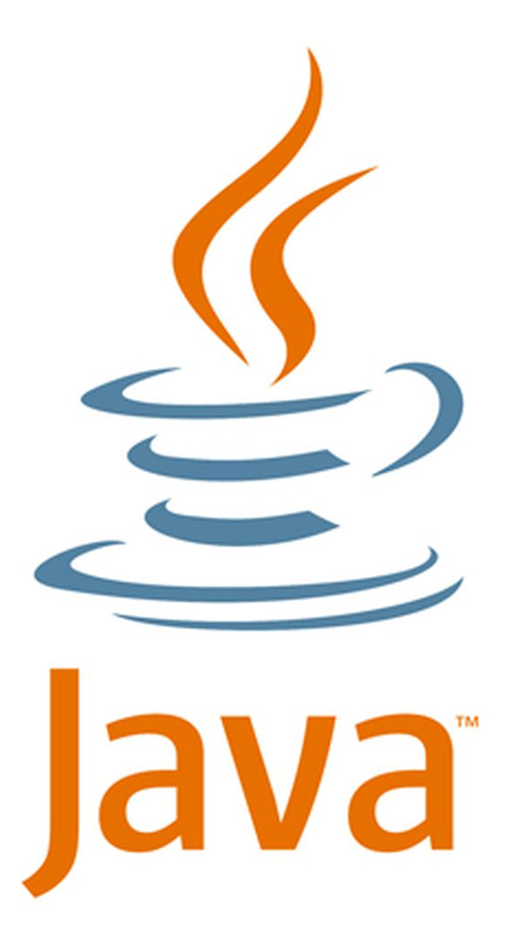


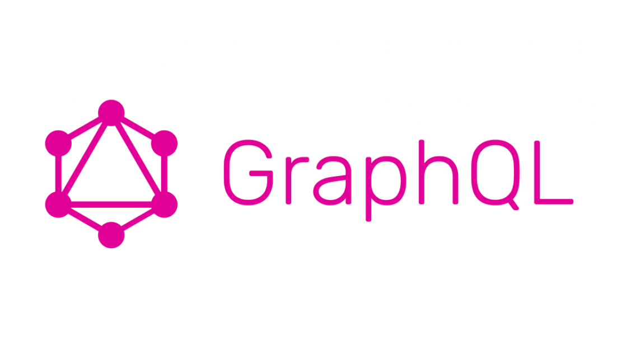



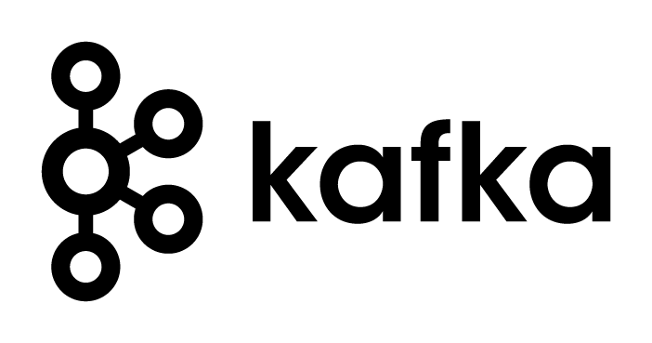


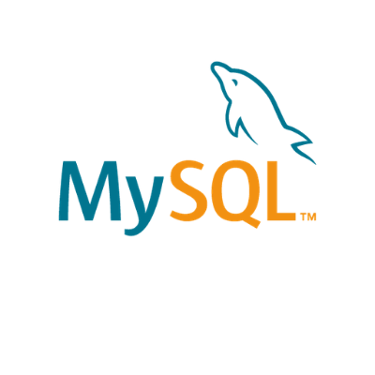

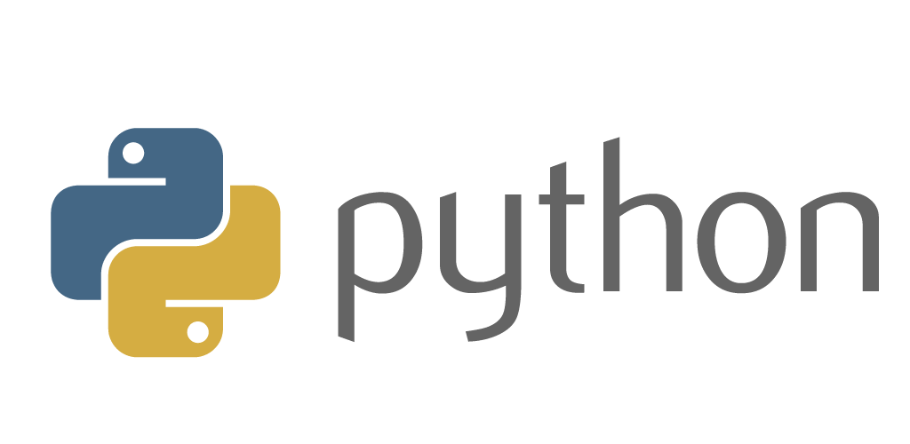
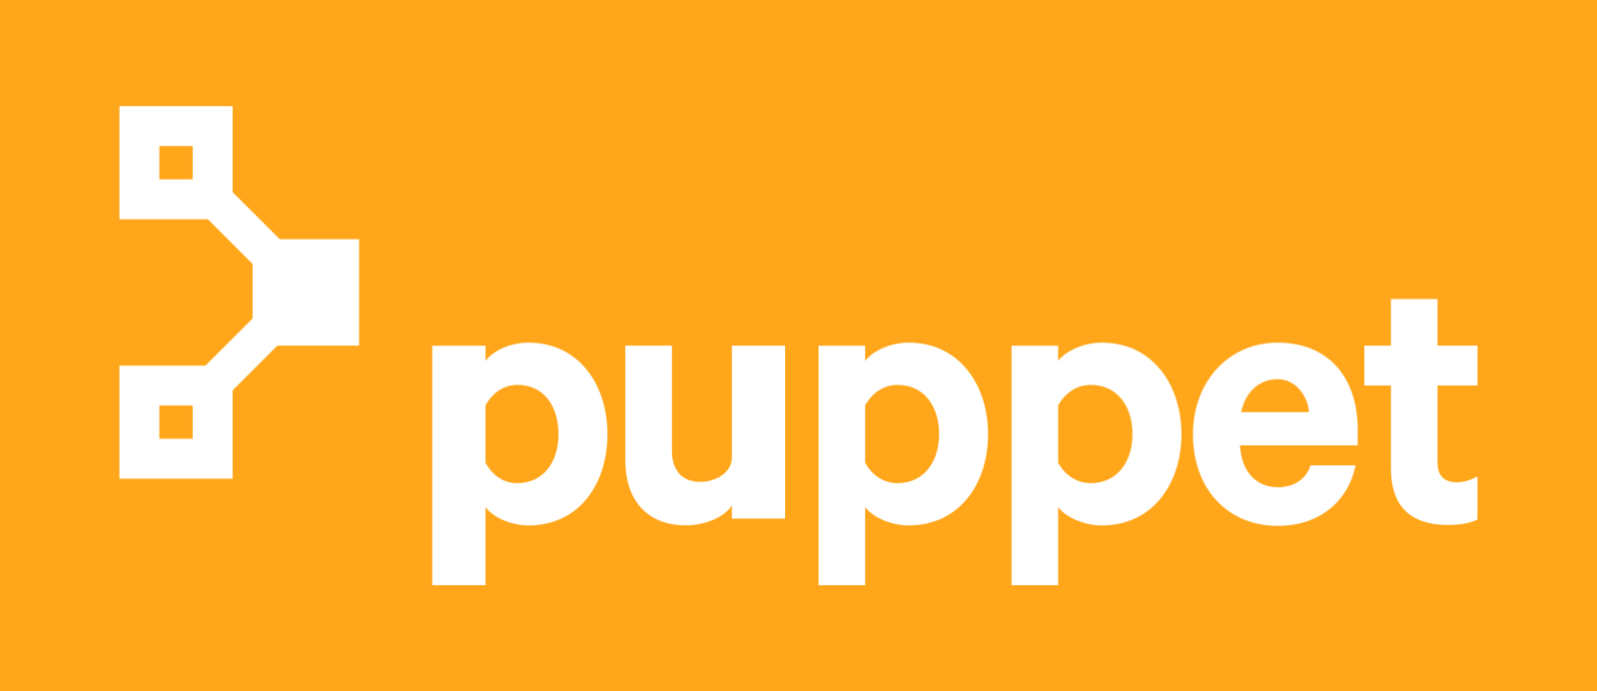

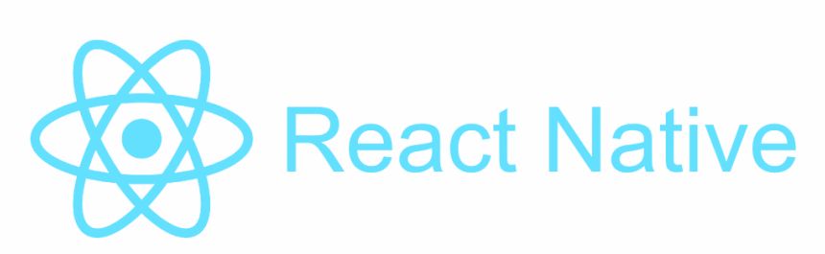
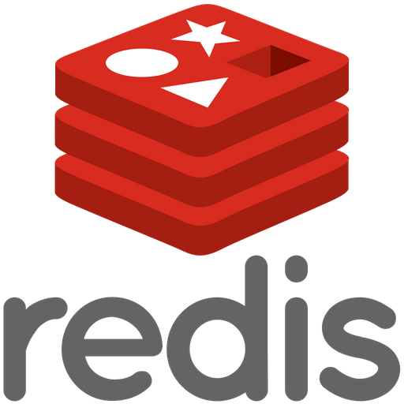


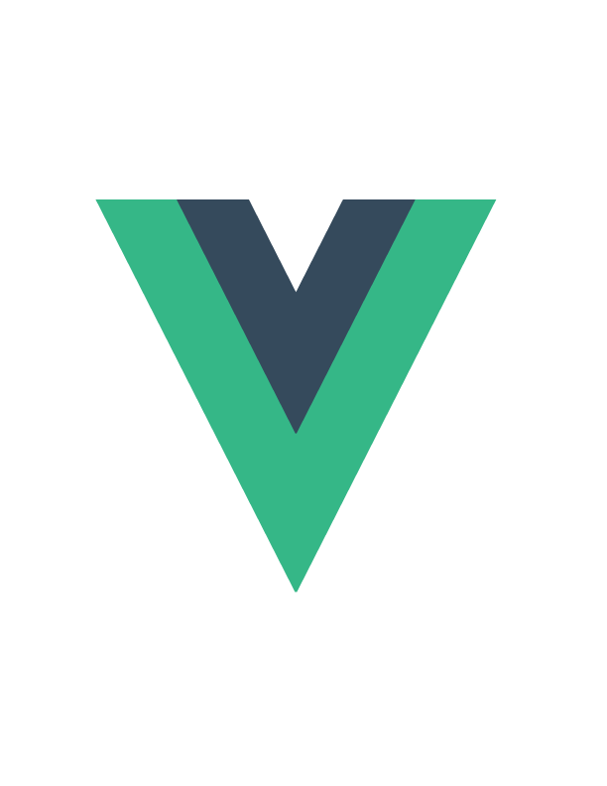

We teach over 400 technology topics
Notes:
Mandatory
Script: DevelopIntelligence teaches a lot of different tech. If there’s a technology you want to learn and you don’t see it in your company’s learning catalog, let your manager know. We’d be glad to help.”

Slide 6



You experience our impact on a daily basis!
Notes:
Mandatory
Script: In your everyday life, you come across tech many times a day. When you shop online. When you pay for your morning coffee. When you watch a movie or travel. We train software developers and IT professionals who work on many of the products and services you use daily.
In fact, when you talk on the phone, watch a movie, connect with friends on social media, drive a car, fly on a plane, shop online, and order a latte with your mobile app, you are experiencing the impact of our solutions.

Slide 7
My pledge to you
I will...
Make this interactive
Ask you questions
Ensure everyone can speak
Use an on-screen timer
Notes:
Mandatory
Script: This is my pledge to you. I’d like to talk in particular about the third bullet. Sometimes in a class, an enthusiastic participant will want to speak out in every discussion, answer every question and so forth. I want to make sure all of you have the opportunity to be heard. So, if I haven’t heard from you in awhile, I may call on you or check in via chat, because I want to make sure everyone gets their questions answered. Also, I want to demonstrate the timer and confirm that everyone can see it. EggTimer is a good timer - https://e.ggtimer.com/

Slide 8
Objectives
At the end of this course you will be able to:
Describe key aspects of iterative software development and understand your role in the process
Participate in Agile work efforts in a confident and meaningful way
Understand and help to improve the DevOps culture at Capital Group
Work within JIRA to manage work and break down complex tasks
Notes:
Mandatory
ACTION: Adjust objectives to fit your course.
Use measurable objectives that start with action verbs such as: describe, define, identify, assess, demonstrate, use, utilize. https://elearningindustry.com/writing-learning-objectives-for-elearning-what-elearning-professionals-should-know

Slide 9
Agenda
Day One
Software development methodologies and iterative software development
Lunch (1 hour)
The Agile Manifesto and best practices in Agile/Scrum
Day Two
Working with JIRA
Lunch (1 hour)
Introduction to DevOps
Notes:
Schedule notes:
- Use Pomodoro (53/7 split?)
- Second break is a little long so TX folks can get a lunch (for the first cohort)

Slide 10
How we’re going to work together
Lab work will take place in individual workspaces – isolated, browser-based virtual machines
Classroom labs may include individual work as well as group discussion and work
I welcome being interrupted – if you need more info, or clarification, or anything else, just break in and ask. I am here to help you.
Notes:
Mandatory
ACTION: Adjust bullets as per your course.
In this section, discuss the structure of the course—exercises, labs, etc.
Also, discuss any resources students will be using.

Slide 11
Software Development Methodologies and Iterative Software Development

Slide 12
Common Approaches to Software Development
Waterfall
Iterative

Slide 13
Waterfall Software Development
A sequential development process that flows like a waterfall through all phases of a project (requirements, design, implementation, testing, and deployment for example), with each phase completely wrapping up before the next phase begins.
Key aspects:
Majority of research done up front
More accurate time estimates
More predictable release date
Cons:
Process is brittle – can’t pivot easily in terms of changing requirements
Long lead times – difficult to respond to rapid business evolution
Tools:
Commonly use Gantt charts to track projects, subtasks and dependencies

Slide 14
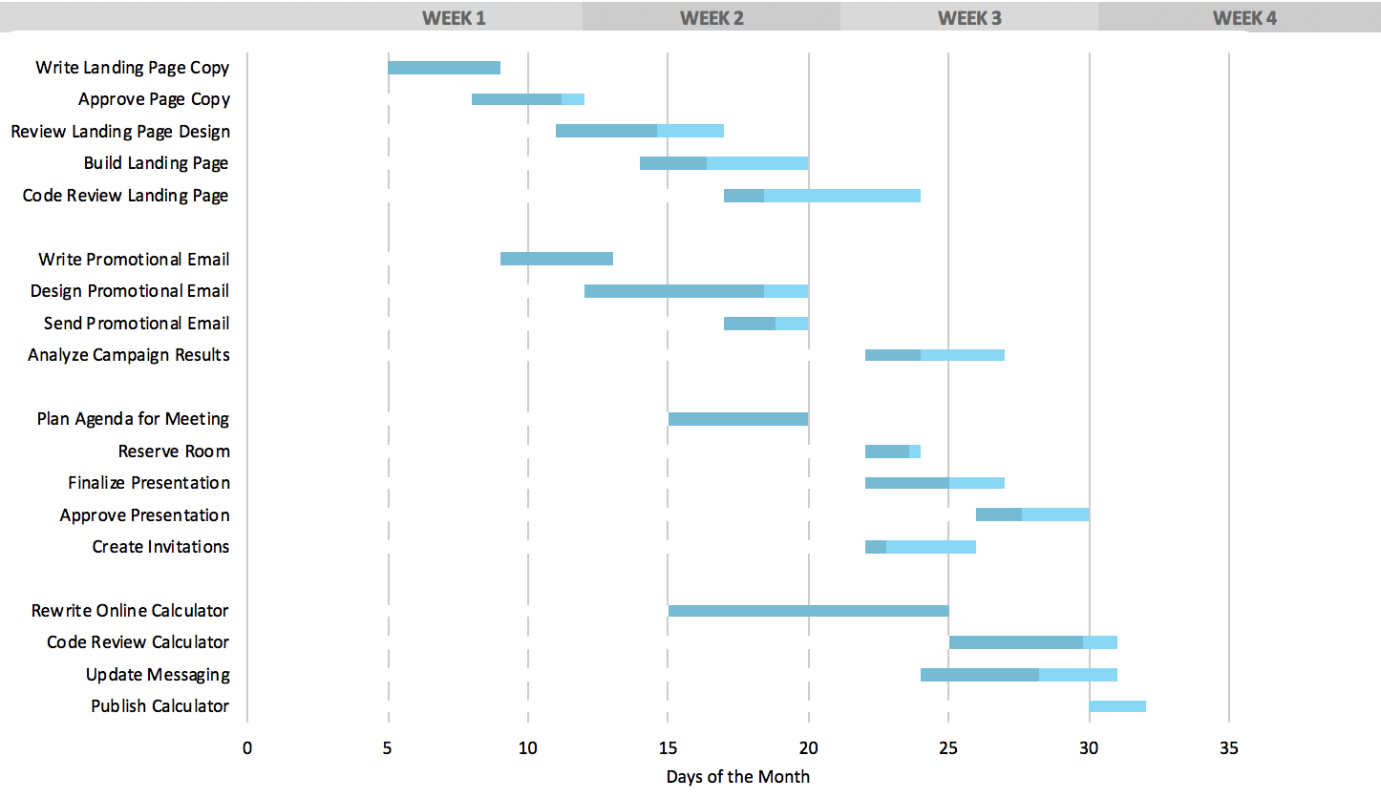
Typical Gantt Chart

Slide 15
Agile Software Development
A group of software development methodologies based on iterative development.
Requirements and solutions evolve through collaboration between self-organizing cross-functional teams.
Key aspects:
Incremental delivery
Always ready to ship
Continuous inspection of work product and process provides feedback for continuous improvement
We will explore Agile in more detail later in this class

Slide 16
ESSAY:
Describe the software development or project management approaches you have worked with, and your opinions on the pros and cons of each
Notes:
This shouldn’t be a long essay, and doesn’t need to conform to university standards ☺
It’s more important that you communicate how the systems worked, in plain language – and what it was like to work in those systems. Talk about WHY you think something worked well, or didn’t
Please write your essay in a .txt file and send it to the instructor
Your experience with various software development systems (3-5 sentences)

Slide 17
Iterative Software Development
Key elements:
Incremental improvement to code and process
Always ready to ship
Iterative feature development
Working with the Product Owner
Pivoting mid-development

Slide 18
Incremental improvement to code and process
Principle: Using feedback obtained from regular examination of product and process lets you incrementally improve both
Key aspects:
Work in short cycles (1-6 weeks) composed of overlapping phases: requirements, design, programming, testing.
Build on what was built before and produce a working product at each stage. Gather customer feedback at the end of each iteration.
Each iteration, evaluate the team’s performance. Change internal process as needed to improve quality of estimation and delivery.

Slide 19
Always ready to ship
Principle: after the first iteration, the product is always "ready to ship". That is, the product does something useful and is in a releasable state.
Key aspects:
This is a risk mitigator – if the project is cancelled or greatly reduces in scope, there is still something of value to show for the work efforts
Projects are less likely to be cancelled, as there is always a working product that shows the project’s value and the team’s competence
Key practices that support this principle:
Do daily software builds
Fix bugs right away
Relentlessly use automated testing to mitigate regression

Slide 20
Iterative Feature Development
Principle: Instead of building all features and then releasing (waterfall), instead develop one feature, then the next, always keeping the application in a shippable state. Continually re-assess priority of feature development, including refinement of existing features, based on feedback
Key aspects:
It is important to work closely with all concerned parties for a system like this to work, and for all involved to understand that development on the application will be iterative – the form of the app presented in one iteration doesn’t necessarily represent the final form of the app, and should not be evaluated as such. Instead, meaningful feedback will allow rapid modification of a feature, while new features are iteratively added to the app
Key practices that support this principle:
Set expectations for all stakeholders
Educate stakeholders on iterative development so they are effective contributors
Be willing to change

Slide 21
Working with the Product Owner
Principle: working closely with the Product Owner enables the incremental production of shippable features that are valuable to the end user
Key aspects:
Consult with the product owner before each iteration, agreeing on the scope and details of work for that iteration.
During the iteration, the external customer or project manager cannot change the scope for that iteration, but the development team may change the scope by dropping features if the end date will not be met.

Slide 22
Pivoting mid-development
Principle: An agile, iterative process can allow a project to pivot in small or large degree, mid-process, without excessive cost of time or resources
Key aspects:
Manage to meet business goals, due dates and budgets. Be willing to change requirements to fit these, not the other way around.
Learn as you go; be adaptable to new or changing business needs that become clear only after development begins.
Analyze existing implementations frequently to determine that they are meeting business goals.

Slide 23
LAB:
We will use a simple Python application for all of our practical work throughout the training. Here, we will examine a running example, then install it locally and get it running.
Notes:
Full-stack app
Back end is written in Python and uses flask web framework
Front end is written in JavaScript and uses React
Review and install the “Reference Implementation” for our training

Slide 24
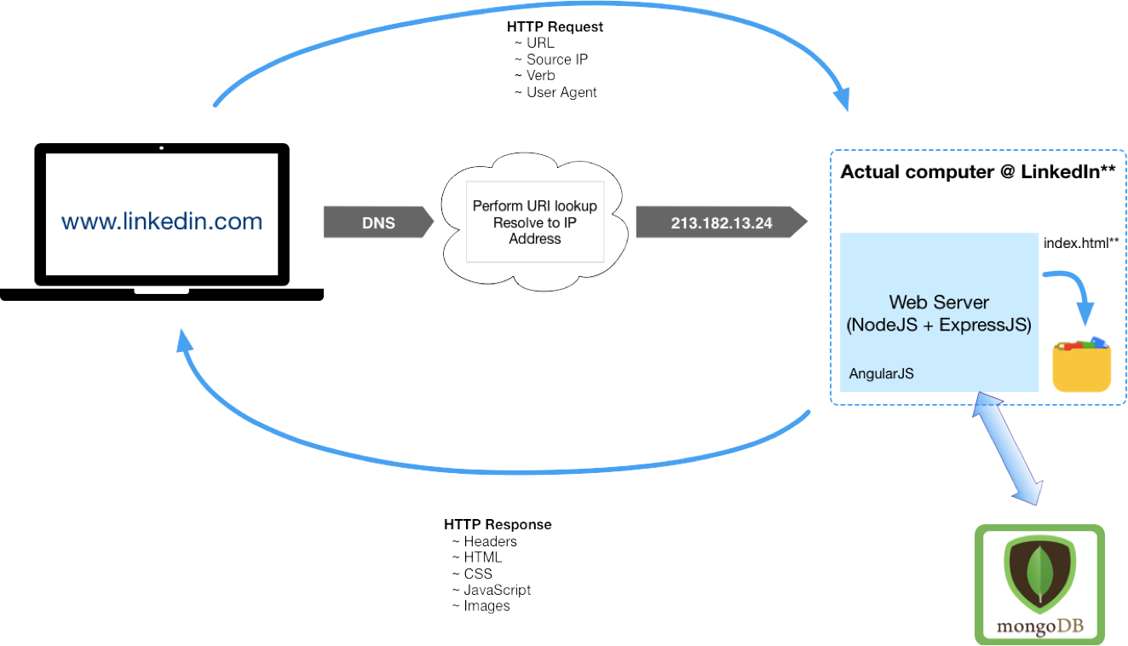
Elements of a Full-Stack App and HTTP Request/Response Cycle

Slide 25
WORKSHOP:
Group discussion considering the Reference Implementation from the following points of view:
What might an iterative approach to the Reference Implementation look like?
What features should ship first?
How might it pivot, based on market or other factors?
Looking at the “Reference Implementation” from an iterative approach

Slide 26
The Agile Manifesto and Best Practices

Slide 27
The Agile Manifesto and its Origins
What is it? A statement of values regarding approaches to how teams create and ship software
When was it made? 2001, by 17 top software developers and consultants
Key aspects:
12 values were agreed upon
These values are NOT a process, implementation or standard; they are opinions
Many popular project management methodologies have arisen that are based on these values
Many Agile implementations are poorly executed; it takes great cooperation between business leadership and a competent, self-guided dev team to make it work

Slide 28
Agile Values
Individuals and Interactions > Processes and Tools
Working Software > Comprehensive Documentation
Customer Collaboration > Contract Negotiation
Responding to Change > Following a Plan

Slide 29
Key Elements of the Agile Approach
The Agile method is an iterative and incremental tactic to software design that utilizes constant planning, understanding, upgrading, team partnership, development, and delivery.
It is driven by the principles of providing value and collaborating with stakeholders.
It starts with customers defining the end uses of the final product and the kind of problems the final product attempts to address.
Designated teams start to plan and work on a complete process through planning, implementing, and appraising.
Since the development process is iterative, errors are resolved in the intermediate stage of the project.

Slide 30
Modern Approaches to Agile Software Development
Several project management approaches implement Agile values in some way. Often, they bring in elements of other approaches.
Popular methodologies:
Kanban – uses visual boards to view and organize tasks. Uses elements of “Just In Time” lean manufacturing strategies, emphasizing throughput
Scrum – aligns closely with Agile values. Breaks down overall development into iterative sprints. Makes use of exclusive roles (“Scrum Lead”, “Product Owner”) and emphasizes constant communication through a daily “scrum” where activities can be aligned.
Scaled Agile Framework (SAFe) – workflow and organizational patterns to help deploy Agile at scale in large organizations.
All three of these approaches are in use in some fashion at Capital.

Slide 31
Common Agile Practices at Capital Group
Common practices are:
Close collaboration between an engaged and knowledgeable Product Owner and a self-organizing dev team with strong ownership for code and team quality
Relentlessly working to break complex tasks down into smaller, more discrete and defined elements
Making use of Scrum boards to track and prioritize work
Sprints run using Scrum principles and practices Continuously evaluate and improve how we choose scope of work for each iteration

Slide 32
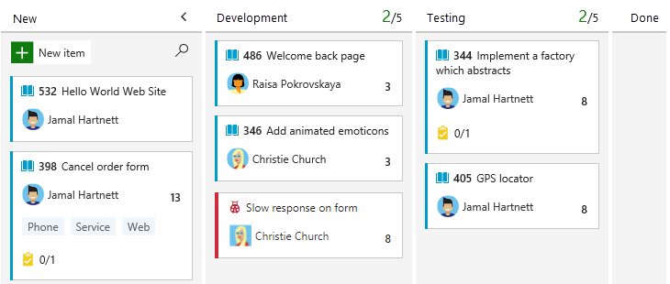
Typical Kanban Board

Slide 33
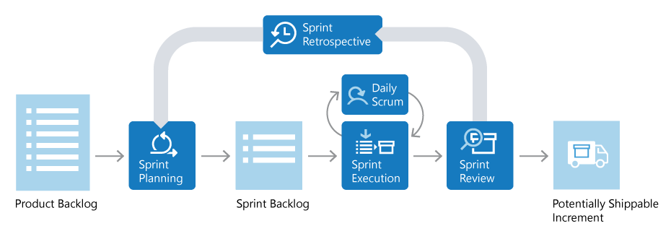
Diagram of Typical Scrum Sprint
Notes:
https://docs.microsoft.com/en-us/devops/plan/what-is-scrum

Slide 34
LAB:
Walk through a typical two-week Agile/Scrum Sprint. Key elements:
Sprint/Iteration
User Stories
Spikes/Epics
Backlog
Backlog and Grooming
Burndown
Definition of Done
Walkthrough of an Agile Sprint

Slide 35
Working with JIRA

Slide 36
Overview of Project and Issue Tracking Software
There are many applications in use to manage tech work – some oriented around service tickets; some around dev tasks, some around both
Popular project and issue tracking software:
JIRA
Asana
Trello
Monday
Zoho
There are MANY others; this is a crowded space
In dev work, integration with tools used in the full dev cycle is important – testing; deployment, monitoring, etc.

Slide 37
Overview of JIRA
JIRA is part of a family of products from Atlassian.
It can be configured to align with popular Agile methodologies.
Key functionality:
Provides a central hub for design, coding, testing, collaboration, release and maintenance
Integrates with CI/CD systems
Provides a feature backlog for planning purposes
Enables Sprint planning

Slide 38
Basic Building Blocks of JIRA
JIRA is built around three basic concepts:
Projects: A collection of Issues, all oriented to one product or work initiative
Issues: The basic element of work in JIRA. Includes the work to be done, as well as metadata about the work. This can be net new work, bug fixes, service tickets, etc. – any type of work
Workflow: A record of the life of an Issue. Issues can only have one state at a given time. Transitions from one state to another can be tracked and controlled as needed

Slide 39
DEMO:
Lifecycle of a JIRA Issue

Slide 40
Using a Scrum Board
Your Scrum board visually represents your workflow – the sequential state changes of your team’s work. A common configuration at Capital Group might be:
New Issues (in the form of features/stories/tasks/bugs, etc.) begin in a Product Backlog, as they are identified
In Sprint Planning, Issues are refined and moved into the Sprint Backlog
Whether assigned a work item, or pulling it yourself, the board lets you choose an Issue and move and then through the states in the defined Workflow for the Project
Often, your actions in other tools will result in a state change for an Issue; the board will update to reflect that change
Because so much of the work activities is tracked electronically, you can also use JIRA’s Control Center to view important metrics about the work of the team and of its members. It tells you about things like: How long an issue sits in a state; average time to complete an Issue; etc.

Slide 41
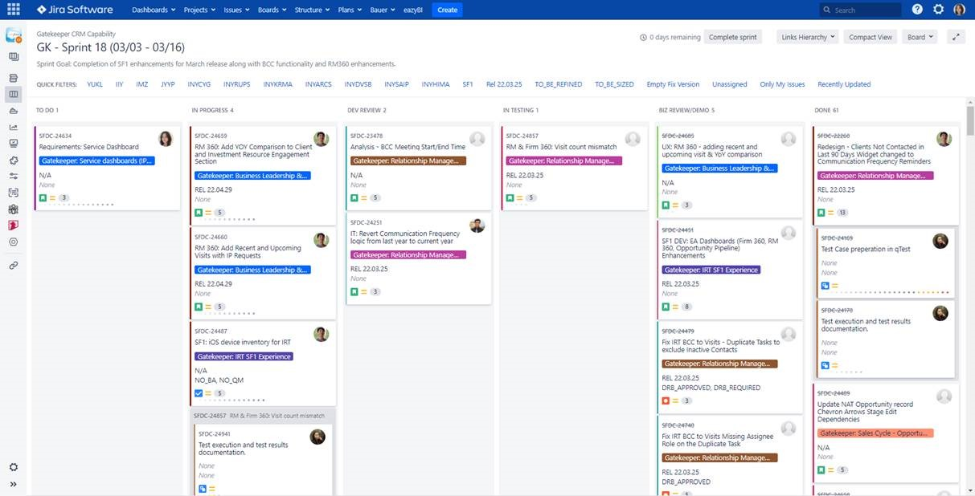
Example Scrum Board

Slide 42
Working With a Product Backlog
Because we use Agile values, and not Waterfall methodology, we need to continuously work with the items in the product backlog. For the most part, the Product Owner owns this backlog.
Mainly this involves two actions:
Re-evaluate the priority of the work items
Break down larger tasks into discrete, well-defined items that can be completed in one Sprint and which move the project forward while still maintaining an always-shippable product

Slide 43
LAB:
Breaking down a large story into smaller tasks

Slide 44
Introduction to DevOps

Slide 45
What is DevOps?
Definition:
“DevOps represents a change in IT culture, focusing on rapid IT service delivery through the adoption of agile, lean practices in the context of a system-oriented approach.
DevOps emphasizes people (and culture), and seeks to improve collaboration between operations and development teams.
DevOps implementations utilize technology— especially automation tools that can leverage an increasingly programmable and dynamic infrastructure from a life cycle perspective.”
DevOps attempted to solve many problems resulting from siloed Dev and Ops teams, and a corresponding lack of understanding, communication and trust.

Slide 46
What isn’t DevOps?
DevOps is NOT a specific process, set of tools or standard. It is a culture.
This means every company’s DevOps approach will be different – but will in some way implement DevOps values.

Slide 47
Key Elements of DevOps
Change in culture
Rapid delivery
Agile/lean methods (feedback, JIT, bottlenecks)
Collaboration between dev and ops
Automation tools across the lifecycle

Slide 48
CALMS model
While every company is unique, a model has been created to assesses a company's ability to adopt DevOps processes, as well as a way of measuring success during a DevOps transformation.
It uses the acronym CALMS:
C: Culture. Tools don’t mean anything if Dev and Ops teams don’t communicate and cooperate. Often, this means creating “product-based” teams, rather that “function-based”
A: Automation. Leveraging automation, particularly programmable infrastructure, reduces risk, increases trust and enables faster throughput in your dev systems
L: Lean. Embrace failure and strive for continuous improvement in code, infrastructure and process. Build for fast detection and rapid recovery.
M: Measurement. Incremental refinement needs hard data to succeed. Implement automated monitoring and feedback systems at the beginning of dev efforts so the risk in complex systems is reduced as you make progress.
S: Sharing. Silos between Dev and Ops are not your friend. Work to increase understanding and mutual responsibility for the whole process among the whole team.

Slide 49
“Shift Left” Testing Approach
DevOps (and its CI/CD automation tools) are all about creating trust – in the tools and processes, and in the code itself. Key to this is testing.
A popular movement in DevOps is called “shift left” testing. It is an approach to software testing and system testing in which testing is performed earlier in the lifecycle (i.e. moved left on the project timeline)
This means developers are getting involved more in testing.
A common tradeoff to examine here: How long does a full set of tests take? How often are devs checking code into the branch that is tested? Do the tests take so long that code changes are getting backlogged? How to we prioritize tests in this situation?

Slide 50
DEMO:
Moving a feature MANUALLY through environments

Slide 51
WORKSHOP:
Group discussion: How would we use the tools of automation and feedback to improve this process?
Improving dev process with automation and feedback

Slide 52
What is DevSecOps?
DevSecOps stands for development, security, and operations. It's an approach to culture, automation, and platform design that integrates security as a shared responsibility throughout the entire IT lifecycle.
Commonly, security is only assessed on a product just before it gets shipped to the Ops environment. If there’s a severe vulnerability, a lot of work may need to be redone, at great expense.
DevSecOps means the whole team is thinking about security from the very start of the product’s life – even in the design stage.
This doesn’t just mean the security of the app itself – it also extends to the security of the infrastructure used to design, build, test and deploy the app.

Slide 53
Thinking Like a Hacker
Without descending a paralysis, we need to acknowledge that there is no digital system made that cannot be compromised, given enough time and resources.
Being security-conscious involves thinking like a hacker. Most will take the easiest, fastest route, and move on to easier targets if those routes fail.
Even if you are not a dedicated security pro, you need to know the fundamentals – and use them in your code and your infrastructure.

Slide 54
Prevention
Security of internet-connected systems and software is a constantly-changing area.
There are common prevention measures one can take, though.
Some of these involve infrastructure – where you use a third-party, examine their security processes very closely. Where you use your own infrastructure, work with security experts to configure it well.
Some of these involve the actual code of your application.

Slide 55
Secure Coding Practices
Secure coding is to design and develop software by avoiding the weaknesses that lead to security-related vulnerabilities by adhering to the specified security standards, and industry best practices.
This means you should:
1. Know your own security standards, developed in-house
2. Know the industry best practices, as well as the most common types of attacks

Slide 56
Common Attack Types
SQL Injection (Improper Neutralization of Special Elements used in an SQL Command)
Integer overflow
Buffer overflow (Buffer Copy without Checking Size of Input)
Uncontrolled format string
Missing authentication and authorization (Incorrect authorization)
Sensitive data exposure
Improper error handling

Slide 57
OWASP Standards
The Open Web Application Security Project (OWASP) is a nonprofit foundation that works to improve the security of software.
They regularly publish info on the most-used attack types for computer systems.
These are called the “OWASP Top Ten” Application Security Risks
They are also a source of useful reference material when assessing your own systems and designing security policies and coding practices.

Slide 58
DEMO:
SQL Injection Attack

Slide 59




Thank you!
If you have additional questions, please reach out to me at:
erik-gross@pluralsight.com

